Slide 1



“
”
A WINNING PARTNERSHIP
Insta-Save Salary Account Opening Steps

Slide 2
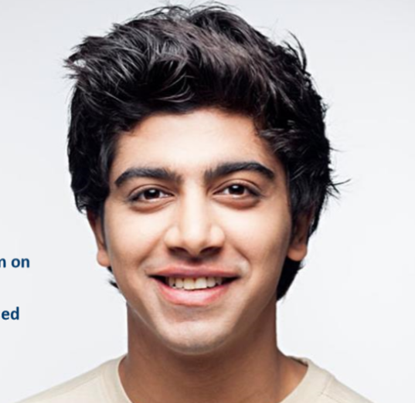



Benefits of ICICI Bank Insta-Save Salary Account
Customized Insta Save Salary Account opening link
Complete digital platform
Account opening
of employees with name mismatch between Aadhaar and PAN
Salary account opened prior to joining date
Convenience for new joinees
Saves travel
time, ensure safety & removes paper work
2 Relationship Managers &
2 Officers to
assist BPM employees -PAN India for online account opening.
Dedicated service team

Slide 3

Account opening steps
Account opening journey to begin by entering mobile number linked with Aadhar & referral codes 477447 or 407227
Enter personal and PAN details
Complete Aadhar authentication
(OTP will be sent on mobile number linked with
Aadhar)
Select Corporate name (other details are auto-fetched basis Aadhar)
Debit card delivered in 7 days as per the address on Aadhaar card
Account number to be shared with the HR
Complete video KYC – to be completed within 72 hrs of Account number generation
Account number generated instantly
Account opening link:
https://buy.icicibank.com/savings-account/product?ius=UWYV00289UW&iup=SALE1CE1X1

Slide 4
Helpdesk contact details
Ashutosh Gupta
Relationship Manager
8924819901
ashutosh.g@icicibank.com
Tulluri Phanikumar
Relationship Manager
8143804676
tulluri.phanikumar@icicibank.com
Divakar B
Sales officer
8095255294
divakar.b@icicibank.com
Shobha Patil
Sales officer
80952552941
shoba.patil@icicibank.com

Slide 5
Helpdesk contact details
NAME | DESIGNATION | Mobile Number | EMAIL ID.
ASHUTOSH KUMAR GUPTA | RELATIONSHIP MANAGER (RM) | 7977083357 | ashutosh.g@icicibank.com
TULLURI PHANI KUMAR | RELATIONSHIP MANAGER (RM) | 7977083135 | tulluri.phanikumar@icicibank.com
AJAY KUMAR | PRIORITY BANKER (PB) | 8097546664 | ajay.k1@icicibank.com
VENKATESH | PRIORITY BANKER (PB) | 7304914191 | venkatesh.ranasube@icicibank.com
DIVAKAR B. | ASSISTANT MANAGER (AM) | 8095255294
SHOBHA PATIL | Relationship officer | 8310648971
THIMMARAJU | Relationship officer | 9632788751
SHAMBHU | Relationship officer | 9886387790

Slide 6
Account opening – points to note
As per RBI guidelines Aadhar and PAN card is mandatory for opening account.
For online account opening, video KYC to be completed with original PAN and Aadhar card
In case of E-Pan, customer can do the Physical KYC at ICICI Bank branch post online
account opening creation at any nearest ICICI bank branch.
If the linked mobile number is not in use or lost, following may do either of the below action:
Customer can update or link mobile number with Aadhar
Customer can open salary account through branch
If customers are not residing as per Aadhar address, either of the below option may be opted for:
if anyone from his/her family is residing at that address, they can collect the welcome kit
After the welcome kit is dispatched, they can contact to customer care number- 18601207777 or email to customer.care@icicibank.com and mention nearest branch address, pin code and IFSC code and collect debit card and cheque book from that branch.

Slide 7
Thank you

